Slide 1


IOT BASED AUTOMATED INDUSTRY
PROTECTION SYSTEM
Group No. 17

Slide 2
Group Members Details
1.Yashwanth S S20220020323
2.Badvel Mahesh Datta S20220020258
3.Himanshu Labana S20220020279

Slide 3
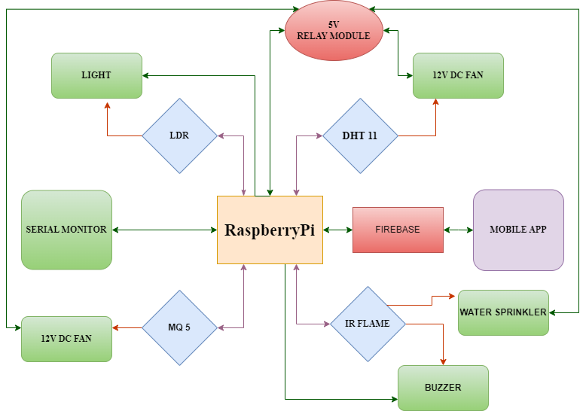
BLOCK DIAGRAM

Slide 4
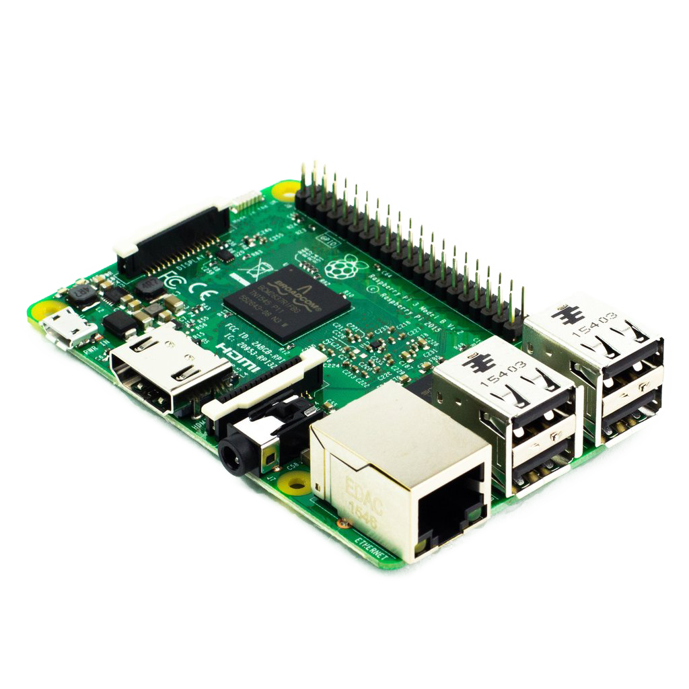
COMPONENTS USED
RASPBERRY PI​
IR FLAME SENSOR​
LDR SENSOR​
MQ-5 GAS SENSOR​
DHT11 TEMERATURE SENSOR​
DC FAN​
WATER SPRINKLER​
LED BULB​
CARD BOARD​
BREAD BOARD​
RECHARGEABLE BATTERY

Slide 5
FINAL OUTPUTS WITH SCREENSHOTS
The "IoT Based Automated Industry Protection System" represents a cutting-edge solution for warehouse safety and operational efficiency. Utilizing Raspberry Pi and a network of sensors strategically positioned throughout the facility, the system provides real-time monitoring and automated responses to various critical events.
The Flame Detection System employs an Infrared sensor to identify fire hazards, triggering immediate alerts on a dedicated mobile application. Simultaneously, a water sprinkler system activates to prevent the escalation of the fire.
Continuous Temperature and Humidity Monitoring, facilitated by a DHT11 sensor, ensures optimal warehouse conditions. The system responds dynamically, activating exhaust fans to regulate temperature and humidity when readings exceed predefined thresholds.
Low Light Level Sensing, using an LDR sensor, triggers automatic illumination in response to insufficient light, enhancing visibility and safety within the warehouse.

Slide 6
FINAL OUTPUTS WITH SCREENSHOTS
Gas Leak Detection, facilitated by MQ-5 gas sensors, allows the system to identify potential gas leaks promptly. In such instances, exhaust fans activate to disperse the gas safely.
All alerts are seamlessly communicated to a dedicated mobile application or website, facilitating swift response and mitigation efforts.
Data collected by the system is stored in Firebase, ensuring secure and accessible storage.
Users can conveniently monitor and analyze warehouse conditions through the dedicated mobile application.
The system's multi-event alert capabilities make it a versatile and comprehensive solution, addressing a spectrum of potential risks including fire hazards, environmental conditions, low visibility, and other safety concerns.
In conclusion, the "IoT Based Automated Industry Protection System" stands as a testament to technological innovation, significantly enhancing the safety and efficiency of warehouse operations through its intelligent and responsive design.

Slide 7
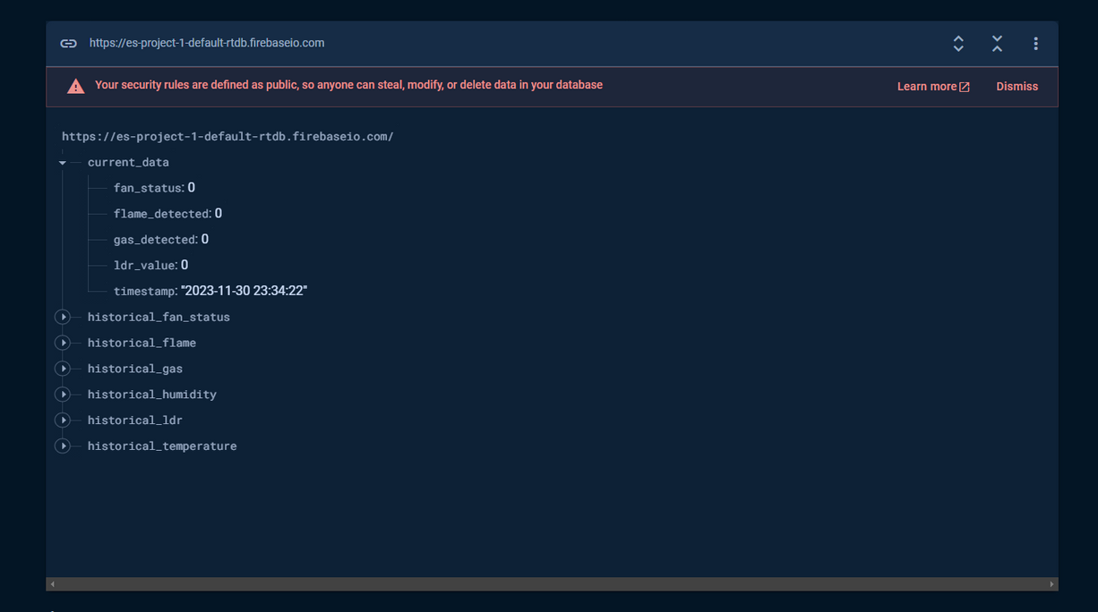
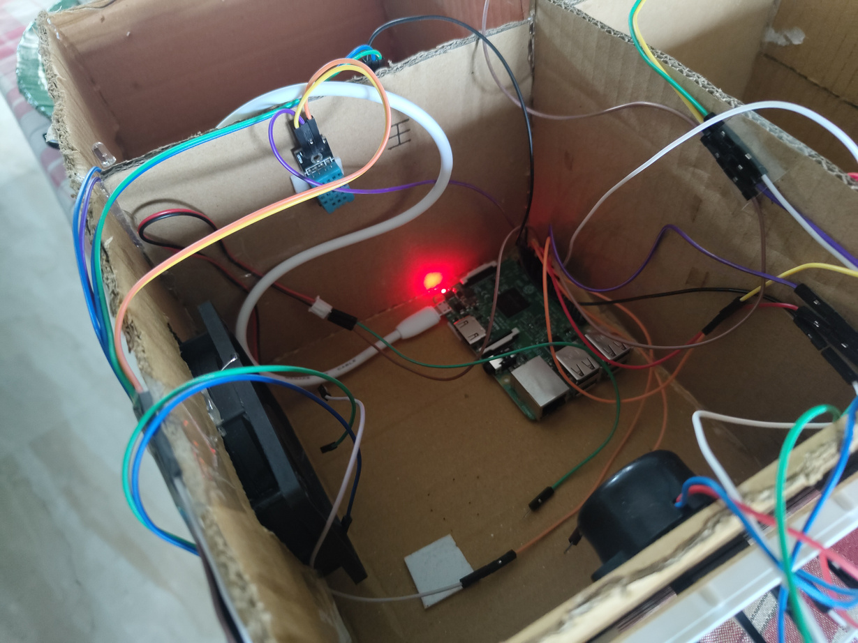

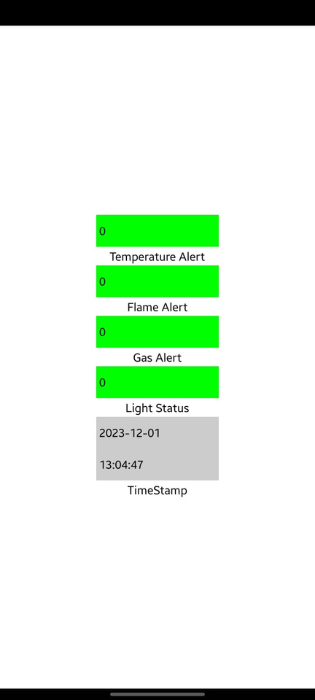
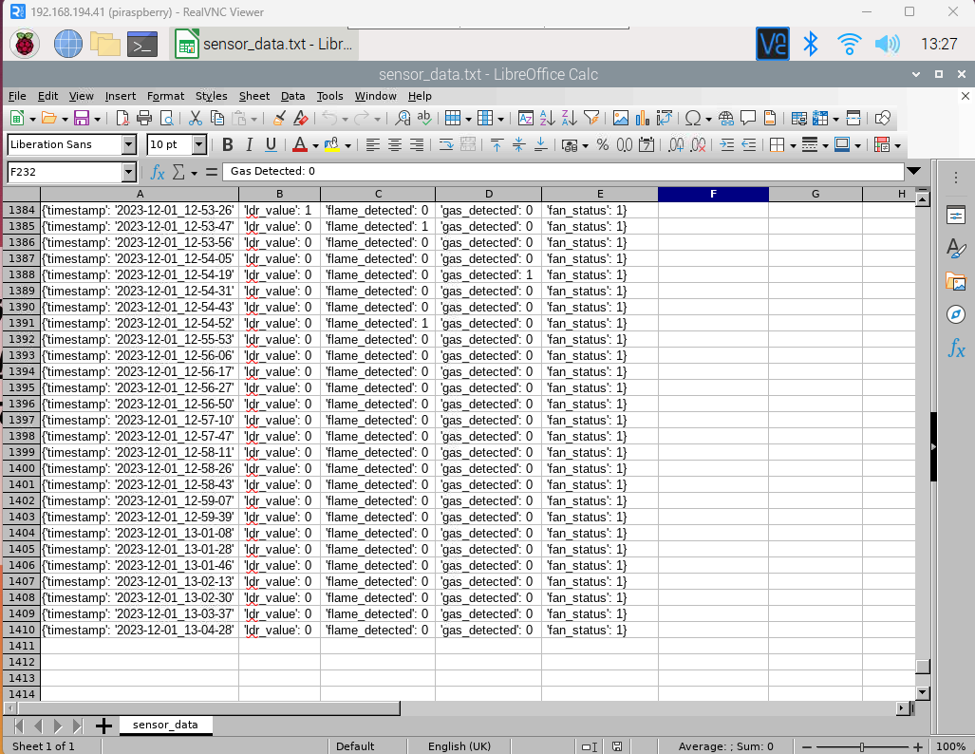
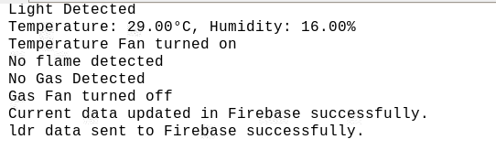

Slide 8
CHALLENGES
Integration of Multiple Sensors:
Coordinating the seamless integration of various sensors, each serving a unique purpose (flame detection, temperature monitoring, low light sensing, gas leak detection), posed a challenge. Ensuring these sensors worked harmoniously to provide accurate and real-time data was a critical aspect of the project.
Real-time Responsiveness:
Achieving real-time responsiveness for critical events, such as flame detection, required minimizing latency in data processing and transmission. Balancing the need for quick responses with the limitations of hardware capabilities demanded meticulous optimization.
Environmental Calibration:
Calibrating sensors to accurately respond to the warehouse environment was a challenge. Factors like varying temperatures, humidity levels, and lighting conditions needed careful consideration to maintain the system's accuracy across different scenarios.

Slide 9
OBSERVATION
Enhanced Safety:
Real-time hazard detection and automated responses significantly improved warehouse safety.
Operational Efficiency:
Monitoring and regulating environmental conditions contributed to optimized operational efficiency.
Versatility:
Multi-event alert capabilities showcased the system's adaptability to diverse risks and scenarios.
Data-Driven Insights:
Storing data in Firebase provided valuable insights for informed decision-making.
User-Friendly Interface:
The dedicated mobile app offered a user-friendly interface for remote system monitoring and control.

Slide 10
THANK YOU

